Slide 1

CN101.3 - Data Communication and Network
Department of Network and Security
Isuru Sri Bandara
isuru.s@nsbm.ac.lk

Slide 2
Module Overview
Course Duration 15 Weeks 13 Lectures + Revision + In Class Test Tutorials Questions + Practical Assignment & Evaluation Exam Weighted 60% Assignments 40% Total 100%

Slide 3

Course Outline
What is Computer Networks ?
What is Internet ?
Introduction to Network Security ?
Layered Architecture ?
Error Detection and Correction ?
Network Layer ?
Wan Technologies ?
Job areas or expert areas that you can focus

Slide 4
What is Data Communication?
Data communications (DC) is the process of using computing and communication technologies to transfer data from one place to another, or between participating parties. -Techopedia- Or Data Communication refers to exchange of data between a source and a receiver.

Slide 5
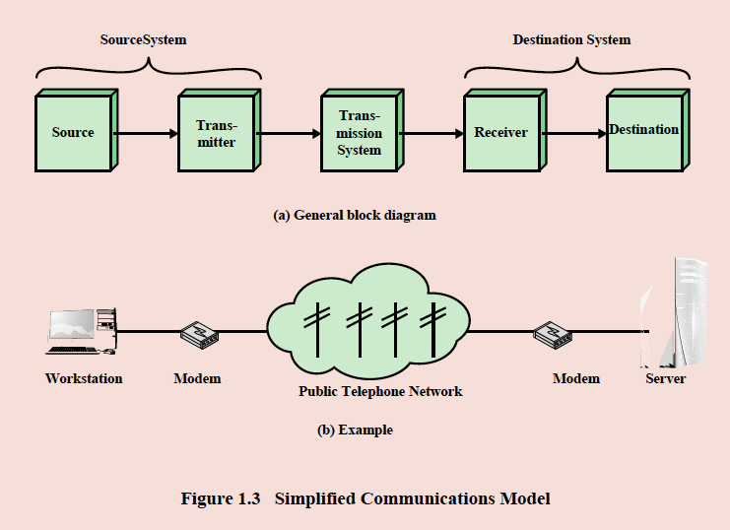
A Simple Model Of A Data Communication System

Slide 6
What is a computer network ?
”A Network is the interconnection of a set of devices capable of communication” – B.A. Forouzan, Data Communication and Networking (2013) A device can be, A host (an end system) such as a large computer, desktop, laptop, workstation, cellular phone or security system. A Connecting device – such as a router (connects networks to other networks); a switch (connects devices together); a modem(modulator – demodulator).

Slide 7

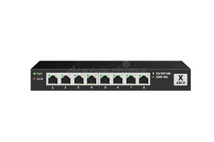

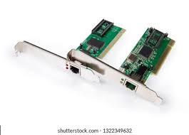
Hardware Requirements for network
Computers (At least 2)
Network Adaptors
Network Cables
Switch /Hub(Hubs are no longer available)

Slide 8
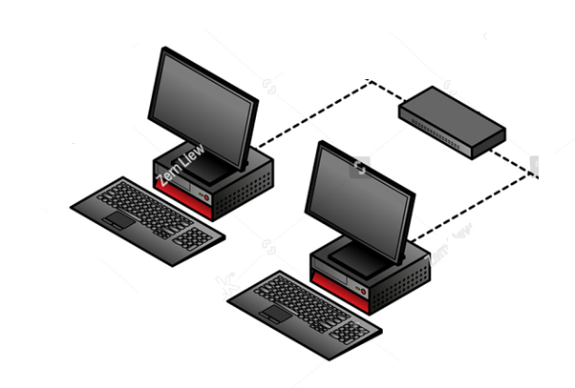
This is how it’s looks like

Slide 9
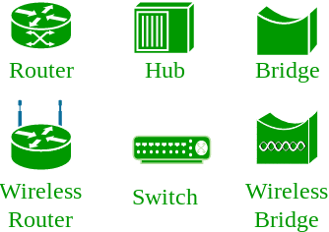
Network Diagram Symbols

Slide 10
Efficiently of Network
A Network has to meet certain criteria for it to operate efficiently
Performance
Reliability
Security

Slide 11
Performance
Network performance can be measured by
1. Measuring the transit time
Transit time is the time taken for a message to travel from one device to another.
2. Response time.
Response time is the elapsed time between an inquiry and response.
Performance depends on many factors,
Number of users,
The type of transmission medium,
The capability of the connected hardware and
The efficiency of software.

Slide 12
Reliability & Security
Reliability
Reliability is measured by the frequency of failure.
If the frequency of failure is low the network has a high reliability
Security
Security is protecting data against unauthorized access

Slide 13

Physical Parts of the Network

Slide 14
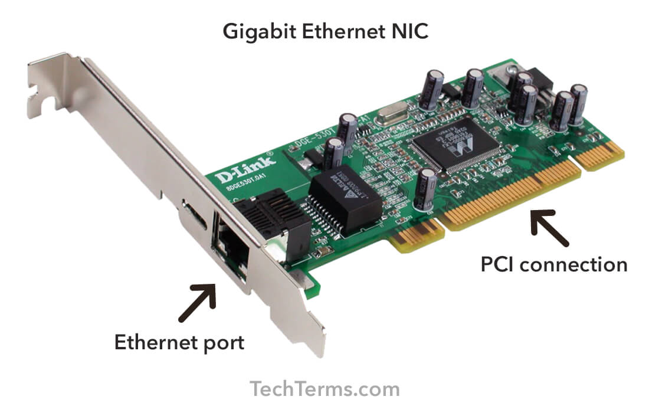
Network Adaptor
A network interface controller is a computer hardware component that connects a computer to a computer network.

Slide 15
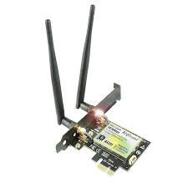
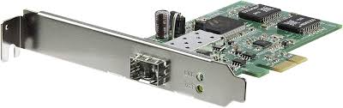
What are the other types of Network Adaptors

Slide 16
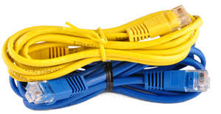
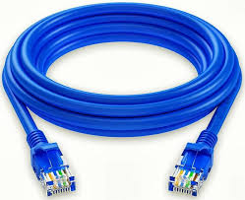
Cables
Networking cables are networking hardware used to connect one network device to other network devices or to connect two or more computers to share printers, scanners etc.

Slide 17
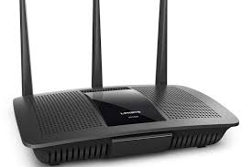
Router
A router is hardware device designed to receive, analyze and move incoming packets to another network. It may also be used to convert the packets to another network interface, drop them, and perform other actions relating to a network.

Slide 18
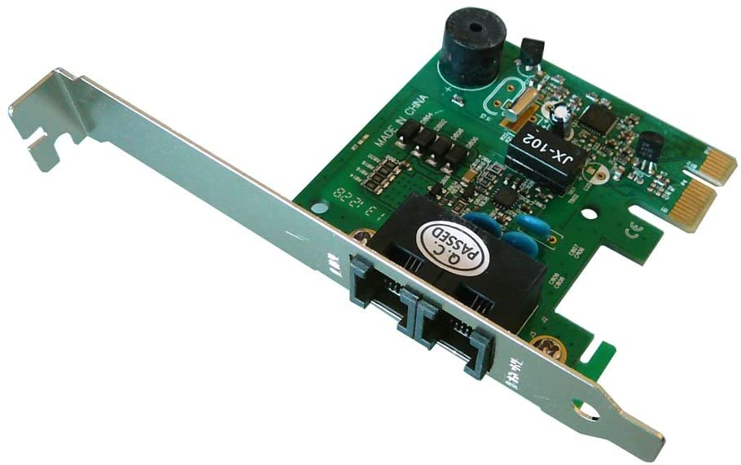
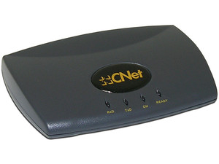
Modem
A modem is a hardware device that allows a computer to send and receive information over telephone lines.

Slide 19
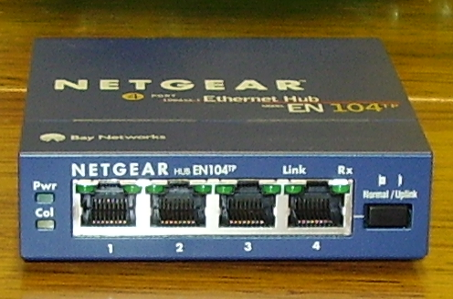
Hub
A hub is the most basic networking device that connects multiple computers or other network devices together.

Slide 20
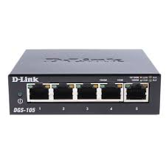
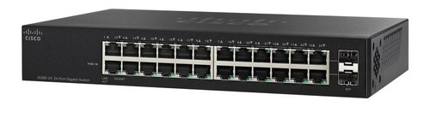
Switch
It is a networking hardware that connects devices on a computer network.

Slide 21
Switch vs Hub
HUB | SWITCH
Transmission mode is Half-duplex | Transmission mode is Full duplex
Hubs operates as a Layer 1 devices per the OSI model | Network switches help you to operate at Layer 2 of the OSI model
Not an intelligent device | Intelligent device
Its speed is up to 10 Mbps | 10/100 Mbps, 1 Gbps, 10 Gbps
Does not use software | Has software for administration

Slide 22
What is Transmission Media
A transmission medium is a physical path between the transmitter and the receiver.

Slide 23
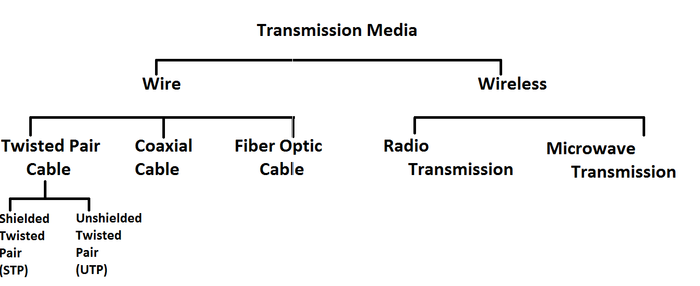
Types of Transmission Media

Slide 24
Guided Media
It is also referred to as Wired or Bounded transmission media. Signals being transmitted are directed and confined in a narrow pathway by using physical links
Features
High Speed
Secure
Used for comparatively shorter distances

Slide 25
Guided media | Twisted Pair
The most popular networking cabling is twisted pair.
It is light weight, easy to install, inexpensive and support many different types of network.
It also supports speed of 100 Mbps.
Twisted pair cabling is made of pairs of solid or stranded copper twisted along each other.
Most commonly used in the telephone network and for communications within buildings.

Slide 26
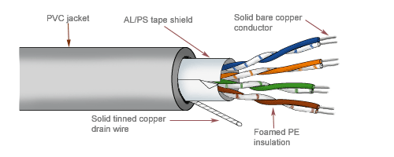
Guided media | Twisted Pair

Slide 27
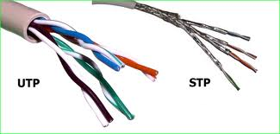
Guided media | Twisted Pair
There are two types of twisted pair cabling
Unshielded twisted pair (UTP)
Shielded twisted pair (STP)

Slide 28
Guided media | UTP | Unshielded twisted pair
There are two types of twisted pair cabling
Unshielded twisted pair (UTP)
Shielded twisted pair (STP)

Slide 29
Guided media | UTP | Unshielded twisted pair
Consists of one or more twisted pair cables.
Typically enclosed within an overall thermoplastic jacket which provides no electromagnetic shielding.
UTP is more common and cost less than STP and easily available due to its many use.
Characteristics of UTP
Low cost
Easy to install
100 meter limit
Advantages of UTP Disadvantages of UTP
Easy Installation Short distance due to attenuation Low Cost
Capable of high speed of LAN

Slide 30
Guided media | UTP | Shielded twisted pair
Consists of one or more twisted pair cables.
Has a metal braid that reduces interference
Characteristics of STP
Medium cost
100 meter limit
Advantages of STP Disadvantages of STP
Shielded More expensive than UTP
Faster than UTP More difficult installation

Slide 31



Coaxial cable is very common & widely used communication media. For example TV wire is usually coaxial.
Guided media | Coaxial Cable
Coaxial cable gets its name because it contain two conductors that are parallel to each other. The center conductor in the cable is usually copper.
Used for TV distribution, long distance telephone transmission and LANs

Slide 32
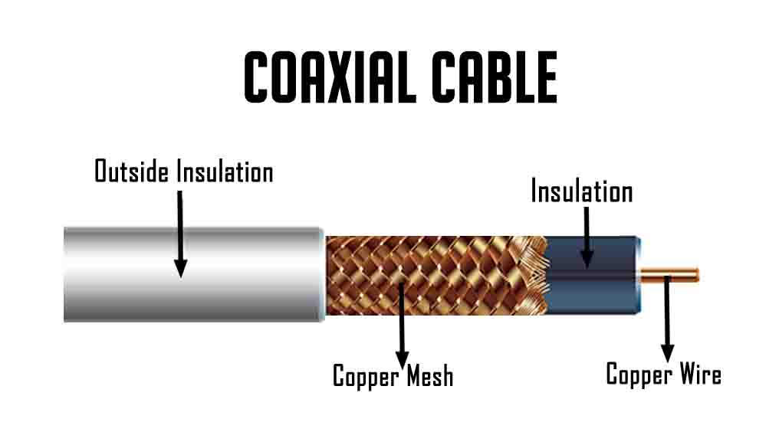
Guided media | Coaxial Cable

Slide 33
Guided media | Coaxial Cable
Transmission Characteristics
Frequency characteristics superior to twisted pair
Performance limited by attenuation and noise
Advantages Disadvantages
Easy to wire Single cable failure can take down entire network
Easy to expand

Slide 34
Guided media | Optical Fiber
Fiber optic cable uses electrical signals to transmit data
It uses the concept of reflection of light through a core made up of glass or plastic.
The core is surrounded by less dense glass or plastic covering called the cladding.
It is used for transmission of large volumes of data.

Slide 35
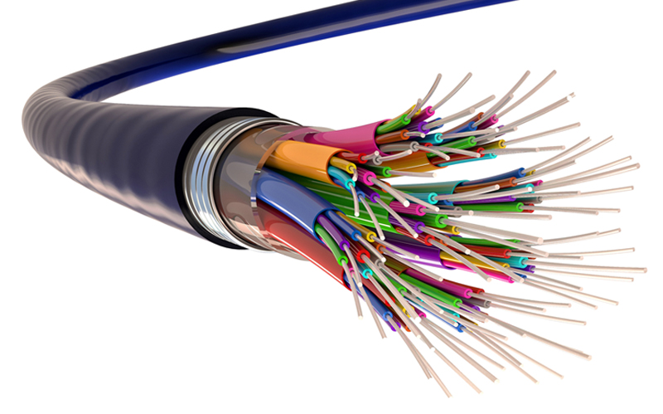
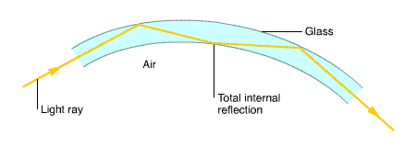
Guided media | Optical Fiber

Slide 36
Guided media | Optical Fiber
Advantages
Greater Capacity
Data rates of hundreds of Gbps over tons of kilometers have been demonstrated.
Smaller size and lighter weight
Considerably thinner than coaxial or twisted pair cable
Lower Attenuation
Disadvantages
Difficult to install and maintain
High Cost

Slide 37
Thank you !

